Slide 1
ME 255 – Strength of Materials
Lecture 6: Analysis of Stress and Strain
By: Samuel Boahen (PhD)

Slide 2
Lecture Outline
Transformation of Plane Stress
Principal Planes
Mohr’s Circle for Plain Stress
Steps in the Construction of Mohr’s Circle
Mohr’s Circle for Plain Strain

Slide 3
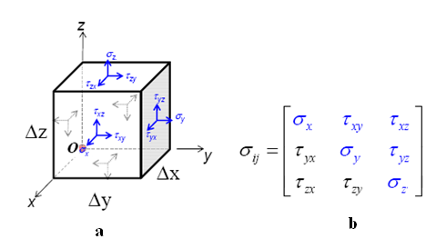
Transformation of Plane Stress
Figure 5-1(a) shows the stresses in all three directions of the Cartesian coordinate system.
These stresses are put together in a matrix form as shown in Figure 5-2 (b) to give the stress tensor.

Slide 4
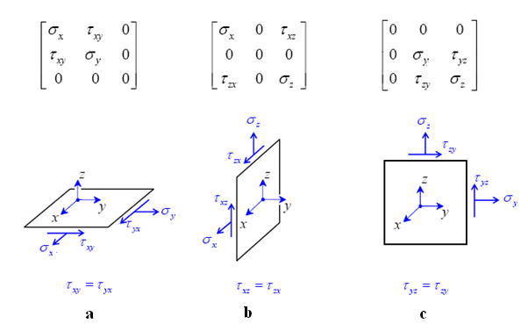
Transformation of Plane Stress
In plane stress condition all stresses in one particular primary direction are equal to zero as illustrated in Figure 5-2.

Slide 5
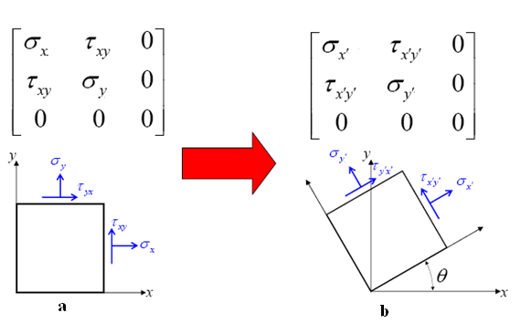
Transformation of Plane Stress
The stresses in the x and y directions can be transformed to the x’ and y’ directions inclined at an angle θ to the x and y axes respectfully.
By resolving and balancing all forces in the new directions.
This transforms the stress state in Figure 5-3a to that in Figure 5-3b.

Slide 6
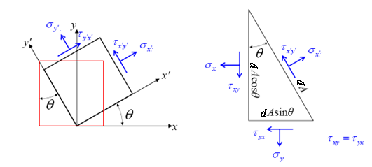
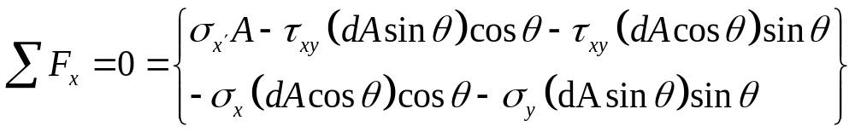
Transformation of Plane Stress
Resolving and summing forces along the x′ followed by y′ direction using Figure 5-4:

Slide 7
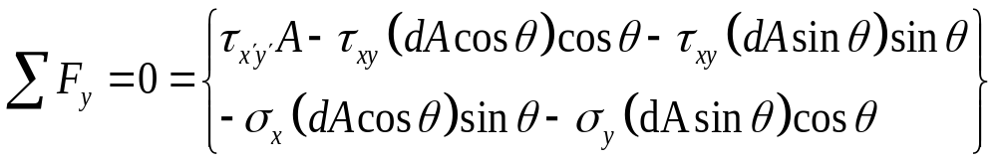
Transformation of Plane Stress
Dividing through by dA and solving for σ_{x’} and τ_{x’y’} yields:
Since σ_{y′} is 90° away from σ_{x′,} σ_{y′} is:

Slide 8
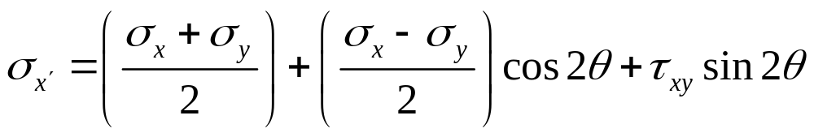

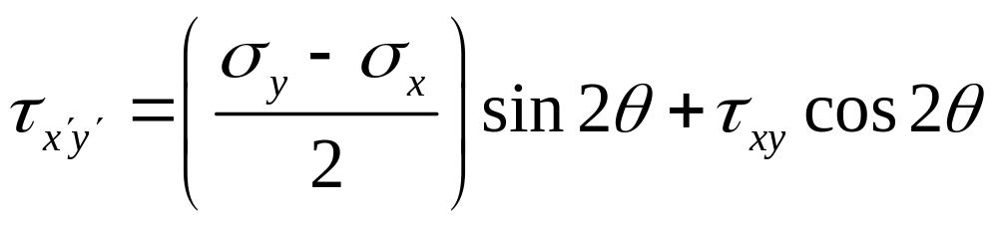
Transformation of Plane Stress
We can rewrite them as

Slide 9
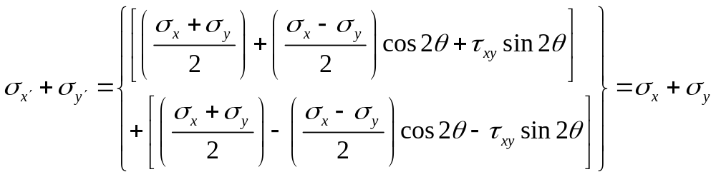
Transformation of Plane Stress
It is observed that for a plane stress situation the sum of the normal stresses exerted on a cubic element of material is independent of the orientation of that element.

Slide 10
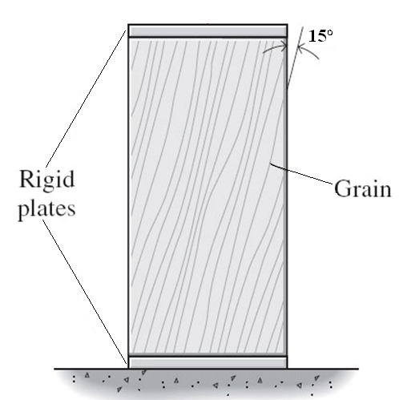
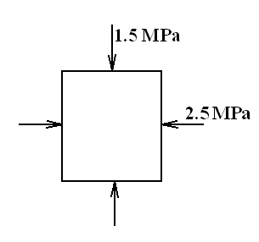
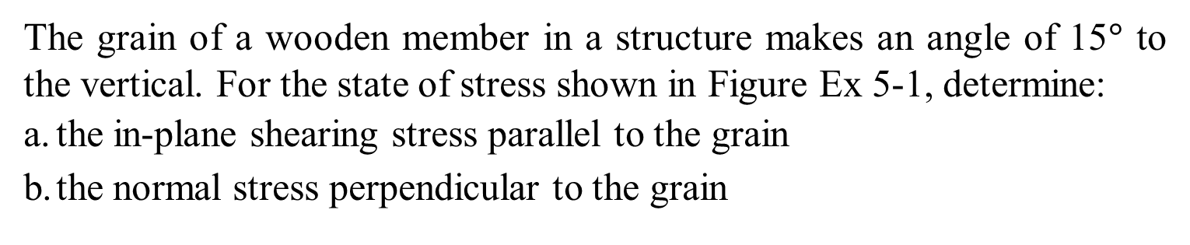
Example 1
The grain of a wooden member in a structure makes an angle of 15$°$ to the vertical. For the state of stress shown in Figure Ex 5-1, determine:
the in-plane shearing stress parallel to the grain
the normal stress perpendicular to the grain

Slide 11
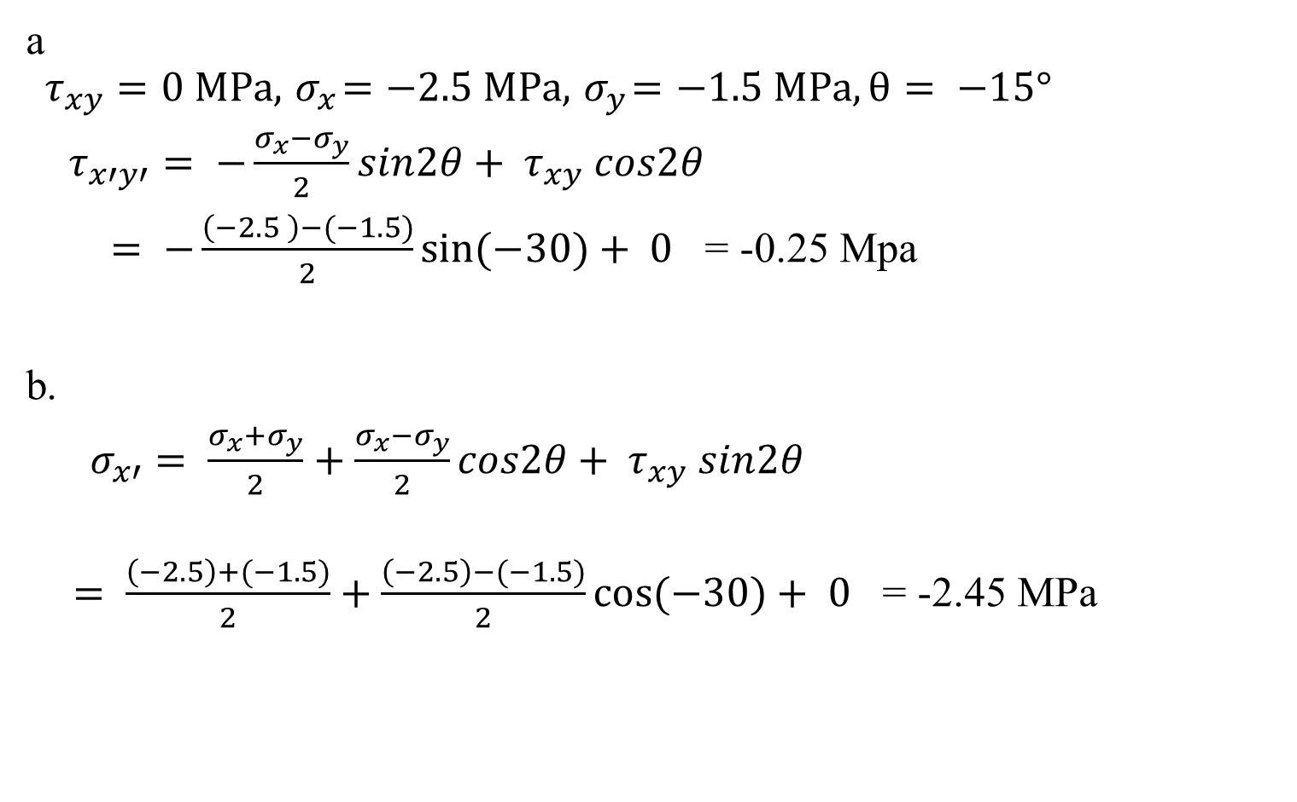
Example 1 Continues
a
$$τ_{xy}=0 MPa, { σ}_{x}=−2.5 MPa, { σ}_{y}=−1.5 MPa, θ= −15°$$
$τ_{x′y′}= −\frac{σ_{x}−σ_{y}}{2}sin2θ+ τ_{xy} cos2θ$
$= −\frac{\left(−2.5 \right)−(−1.5)}{2}sin(−30)+ 0$ = -0.25 Mpa
b.
$σ_{x′}= \frac{σ_{x}+σ_{y}}{2}+\frac{σ_{x}−σ_{y}}{2}cos2θ+ τ_{xy} sin2θ$
$= \frac{\left(−2.5\right)+(−1.5)}{2}+\frac{\left(−2.5\right)−(−1.5)}{2}cos(−30)+ 0$ = -2.45 MPa

Slide 12
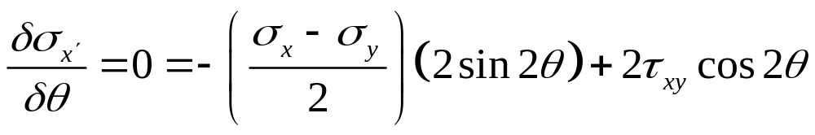
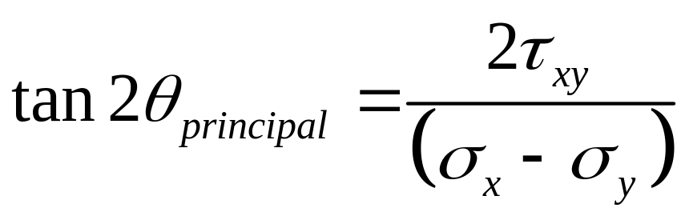
Principal Planes
Planes that have no shear stress are called principal planes.
Principal planes carry only normal stresses
The normal stress, σ_{x’} is maximum or minimum when its derivative is equal to zero:
Solving for θ yields the plane where maximum and minimum normal stresses occur.

Slide 13
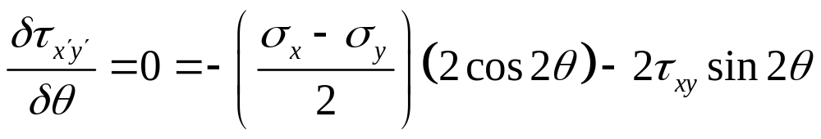
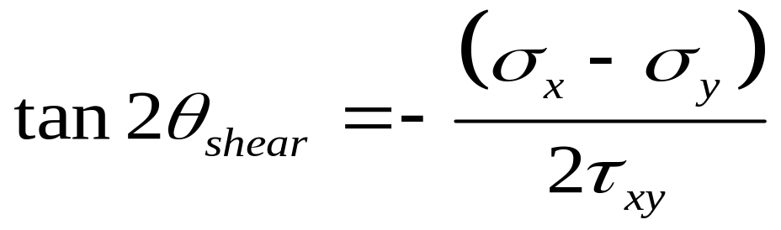
Principal Planes
Similarly, to find the plane on which the shear stress is maximum, the derivative of τ_{x’y’} can be used.
The maximum in-plane shear stress can therefore be found as follows:
Solving for θ yields the plane of maximum/minimum shear stress

Slide 14
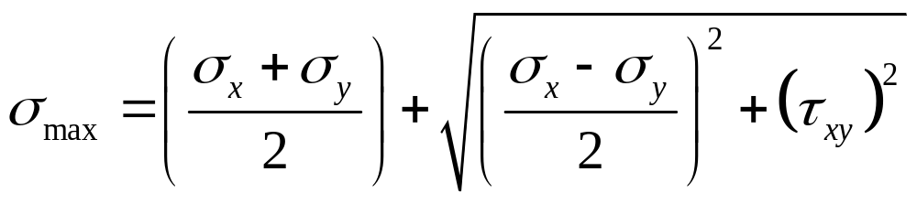
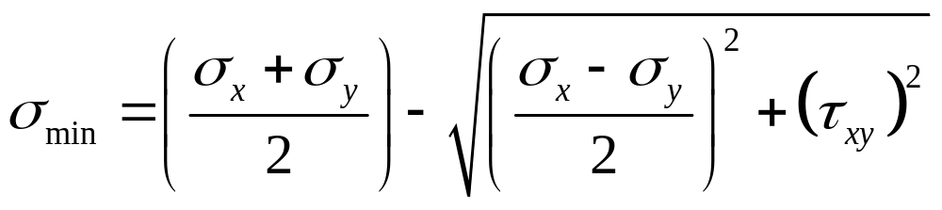
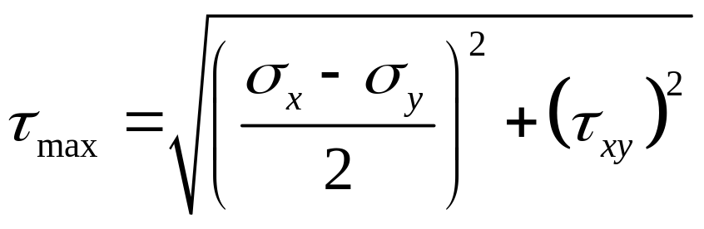
Principal Planes
The two principal stresses and the maximum shearing stress are:

Slide 15
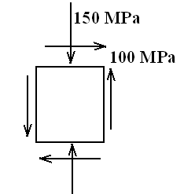
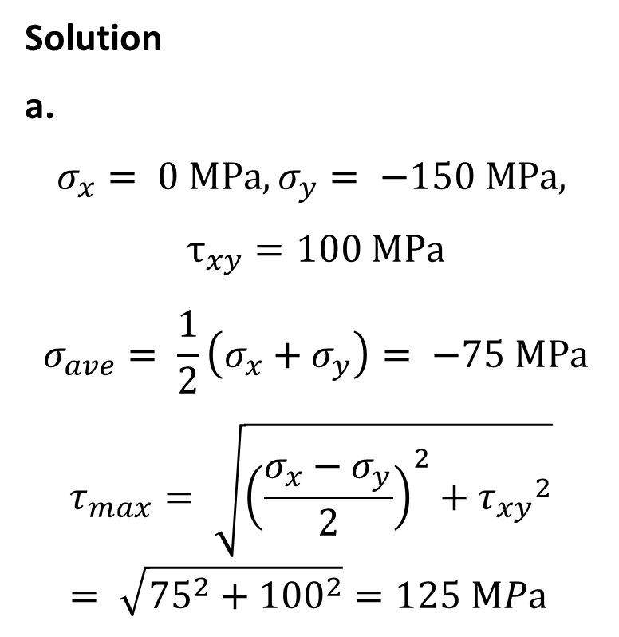
Example 2
For a cast iron material with ultimate tensile strength of 160 MPa, and ultimate compression strength of 320 MPa, having the stress conditions shown in Figure Ex 5-2 determine:
The maximum shearing stress
The principal stresses
Solution
a.
$$σ_{x}= 0 MPa,σ_{y}= −150 MPa,$$
$$τ_{xy}=100 MPa$$
$$σ_{ave}= \frac{1}{2}\left(σ_{x}+σ_{y}\right)= −75 MPa$$
$$τ_{max}= \sqrt{{\left(\frac{σ_{x}−σ_{y}}{2}\right)}^{2}+{τ_{xy}}^{2}}= \sqrt{{75}^{2}+{100}^{2}}=125 MPa$$

Slide 16
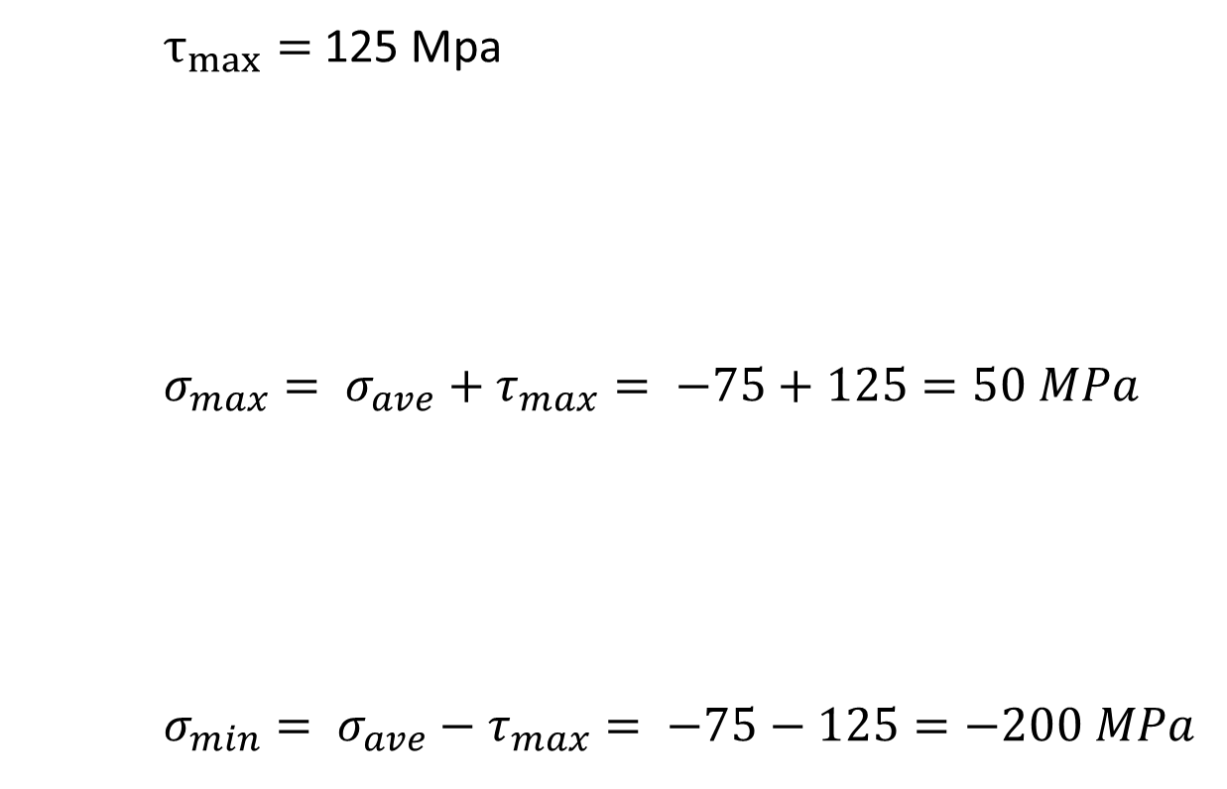
Example 2 Continues
$τ_{max}=$125 Mpa
$$σ_{max}= σ_{ave}+τ_{max}= −75+125=50 MPa$$
$$σ_{min}= σ_{ave}−τ_{max}= −75−125=−200 MPa$$
b)

Slide 17
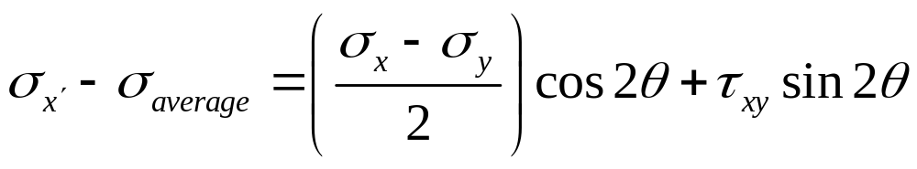
Mohr’s Circle for Plain Stress
The Mohr’s stress provides a graphical way of representing the transformation of stress equations.
The equation for the Mohr’s circle can be derived by rearranging the stress transformation equations.
Re-write the equations 5-7 and 5-9 as:

Slide 18
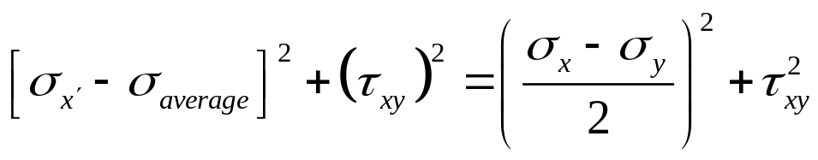
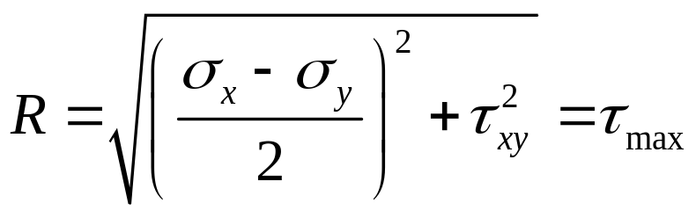
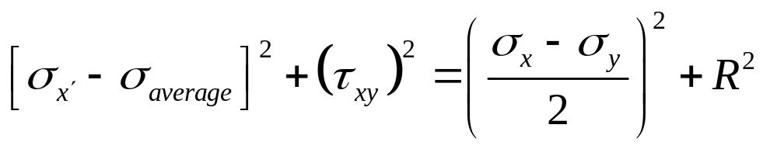
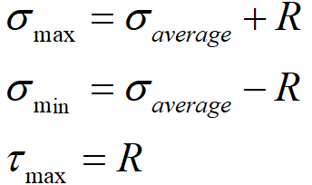
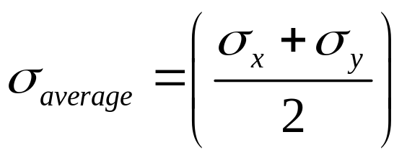
Mohr’s Circle for Plain Stress
Squaring both sides of each equation and adding them together yields:
Equation for a circle expressed in (σ, τ) coordinates with a center at (σ_{average}, 0), where σ_{average} is
The radius of Mohr’s circle, R is:
Therefore

Slide 19
Steps in the Construction of Mohr’s Circle
Draw a state of stress free body diagram. i.e. show the stresses σ_{x}, σ_{y}, and τ_{xy} on a cube. Label the vertical plane V and the horizontal plane H.
Write the coordinates of points V and H as V(σ_{x}, - τ_{xy}) and H(σ_{y}, τ_{xy}). A positive value for σ_{ij} produces a clockwise (CW) moment about the center of the cube (i.e. CW rotation of the cube).
Draw the horizontal axis with the tensile normal stress to the right (i.e. positive) and the compressive normal stress to the left (i.e. negative).

Slide 20
Steps in the Construction of Mohr’s Circle
Locate points V and H and join the points by drawing a line. Label the point where line VH intersects the horizontal axis as C, the center of the circle. The center has coordinates C (σ_{average}, 0).
Draw Mohr’s circle with point C as the center and a radius, R of length CH or
The angle between lines CV and Cσ₁ is labeled 2θ because the angles on Mohr’s circle are double the actual angle between planes.

Slide 21
Steps in the Construction of Mohr’s Circle
To determine the direction of rotation (i.e. the sign) we first record the direction in which we move from point V(σ_{x}, -τ_{xy}) to point (σ₁, 0) on Mohr’s circle. If the direction of rotation is CCW (i.e. towards the positive shear direction), then the sign of θ is positive. If the rotation is CW then the sign of θ is negative.
This is illustrated in Figure 5-8.

Slide 22
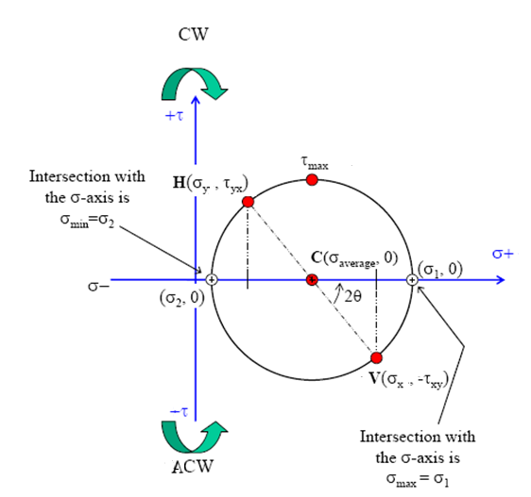
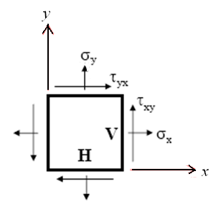
Steps in the Construction of Mohr’s Circle
Figure 5-8

Slide 23
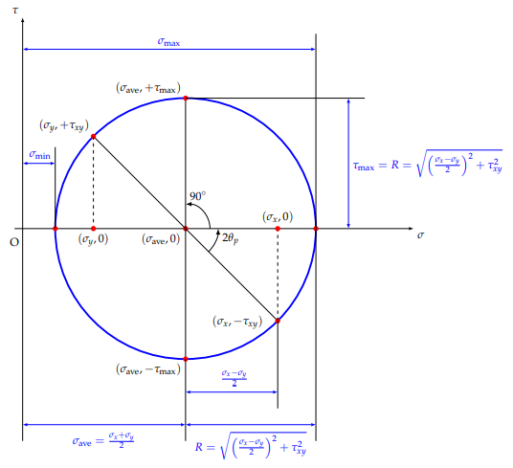
Mohr’s circle

Slide 24
Example 3
Consider a point in a solid that is subjected to the following state of stress:
σ_{x} = 90 MPa;
σ_{y} = -50 MPa;
τ_{xy} = -60 MPa.
Draw a free body diagram representing the stress state.
Determine the principal stresses, the maximum in-plane shear stress acting on the point, and the orientation of the principal planes using Mohr’s circle.
Show the stresses on an appropriate diagram.

Slide 25
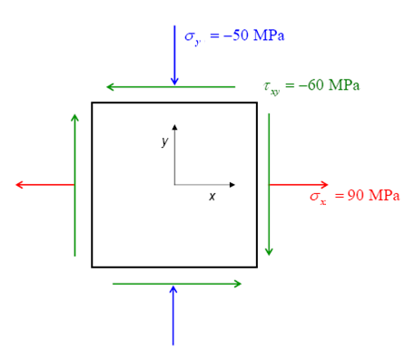
Example 3 Continues
V = (σ_{x}, -τ_{xy} ) = (90, 60)
H = (σ_{y}, + τ_{xy} ) = (-50, -60)

Slide 26
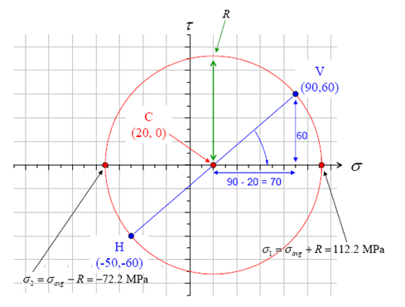
Example 5-3 Continues

Slide 27
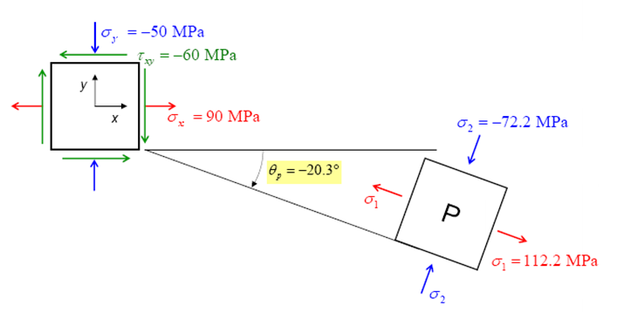
Example 3 Continues

Slide 28
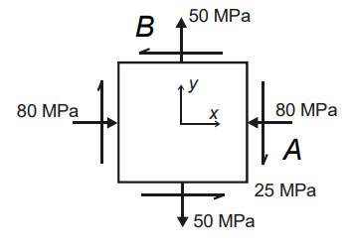
Example 4
The state of plane stress at a point is represented by the stress element below. Draw the Mohr’s circle, determine the principal stresses and the maximum shear stresses, and draw the corresponding stress elements.

Slide 29
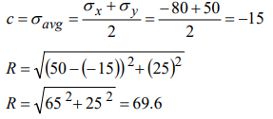
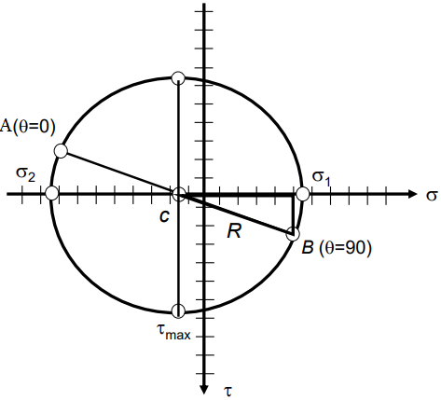
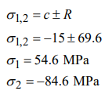
Solution

Slide 30
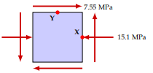
Tutorial 1
Solve Problem below using Mohr’s circle

Slide 31


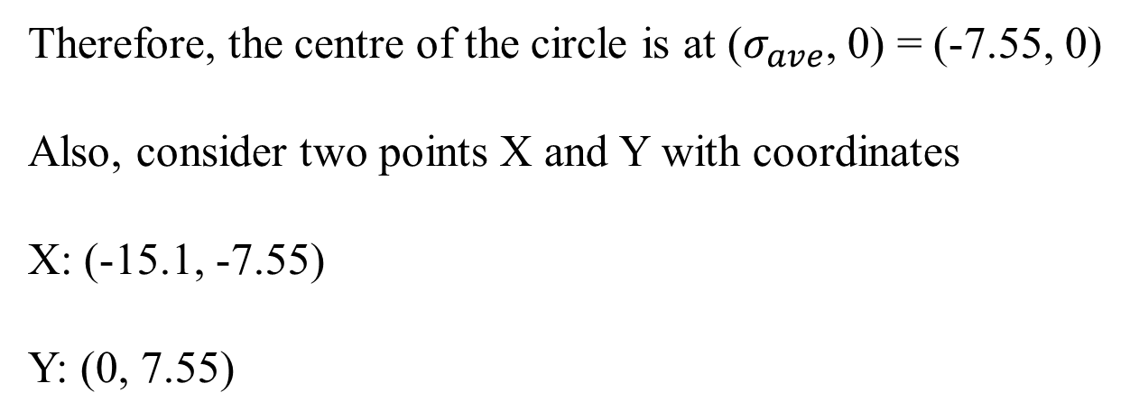
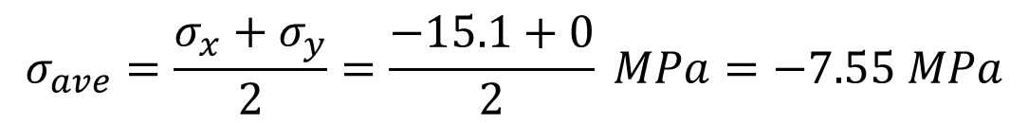
Solution
$$σ_{x}=−15.1 MPa$$
$$σ_{y}=0 MPa$$
$$σ_{ave}=\frac{σ_{x}+σ_{y}}{2}=\frac{−15.1+0}{2} MPa=−7.55 MPa$$
Therefore, the centre of the circle is at ($σ_{ave}$, 0) = (-7.55, 0)
Also, consider two points X and Y with coordinates
X: (-15.1, -7.55)
Y: (0, 7.55)

Slide 32
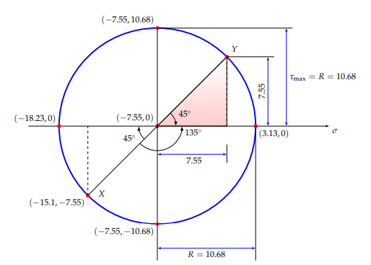
Solution Cont.

Slide 33
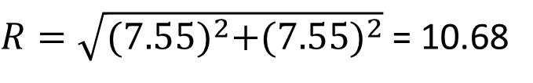

Solution cont.
Using the (red) shaded right-angled triangle, the radius of
the Mohr’s circle is given by
$$R^{2}={(7.55)}^{2}+{(7.55)}^{2}$$
$R=\sqrt{{(7.55)}^{2}+{(7.55)}^{2}}$ = 10.68
$$σ_{max}=σ_{ave}+R=−7.55+10.68=3.13 MPa$$
$$σ_{min}=σ_{ave}−R=−7.55−10.68=−18.23 MPa$$
$$The maximum in−plane shear stress, τ_{max}=R=10.68 MPa$$

Slide 34
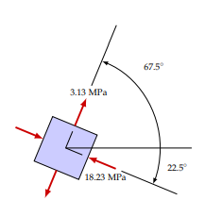
Solution cont.

Slide 35
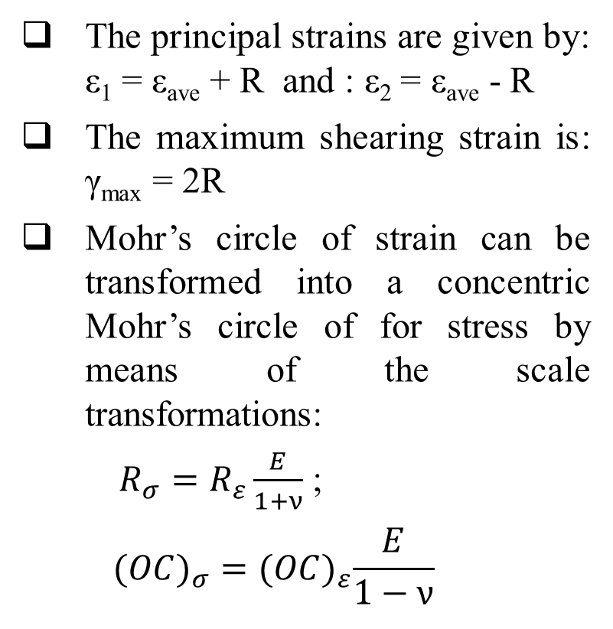
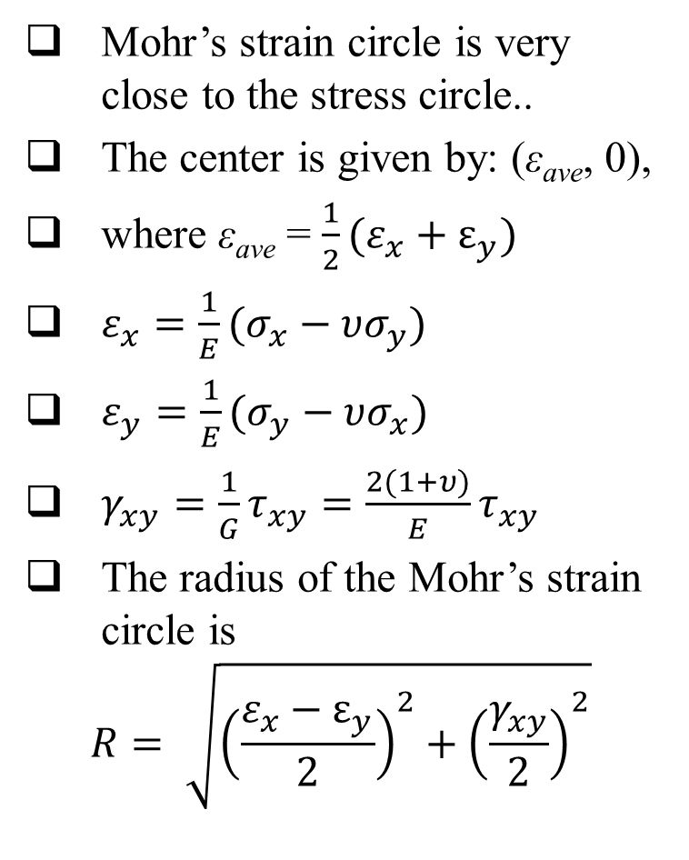
Mohr’s Strain Circle
Mohr’s strain circle is very close to the stress circle..
The center is given by: (ε_{ave}, 0),
where ε_{ave} = $\frac{1}{2}(ε_{x}+ε_{y})$
$ε_{x}=\frac{1}{E}(σ_{x}−υσ_{y})$
$ε_{y}=\frac{1}{E}(σ_{y}−υσ_{x})$
$γ_{xy}=\frac{1}{G}τ_{xy}=\frac{2(1+υ)}{E}τ_{xy}$
The radius of the Mohr’s strain circle is
$$R= \sqrt{{\left(\frac{ε_{x}−ε_{y}}{2}\right)}^{2}+{\left(\frac{γ_{xy}}{2}\right)}^{2}}$$
The principal strains are given by: ε₁ = ε_{ave} + R and : ε₂ = ε_{ave} - R
The maximum shearing strain is: γ_{max} = 2R
Mohr’s circle of strain can be transformed into a concentric Mohr’s circle of for stress by means of the scale transformations:
$R_{σ}=R_{ε}\frac{E}{1+ν}$ ;
$$(OC)_{σ}={(OC)}_{ε}\frac{E}{1−ν}$$

Slide 36
Example 5
Using the values in Example 5-3, Determine the principal strains, the maximum in-plane shear strain acting on the point, and the orientation of the principal planes using Mohr’s circle. Take Young’s Modulus = 200 kPa and Poisson ratio = 0.3
Solution

Slide 37
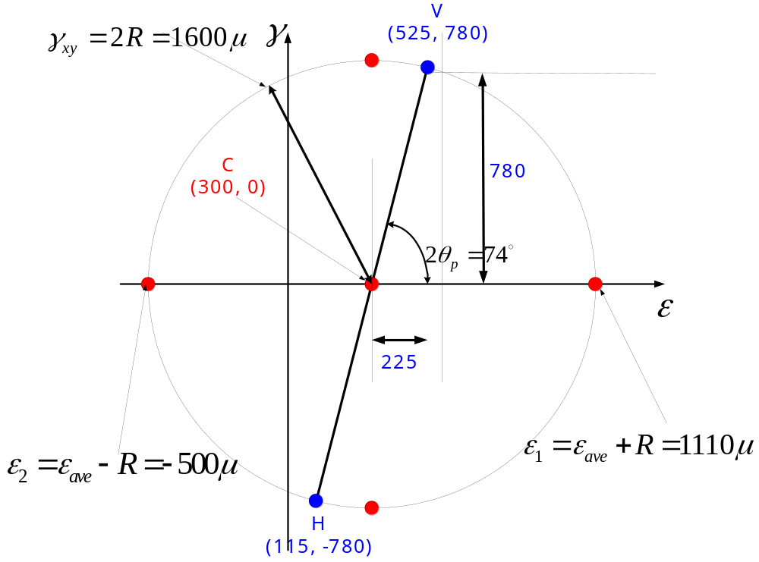
Example 5 Continues
V = (ε_{x}, -γ_{xy} ) = (525, 780); H = (ε_{y}, + γ_{xy} ) = (115, -780)

Slide 38
THANK YOU

